Slide 1

Power Pages Jumpstart:
Building Dynamic Web Applications
Creating and managing Power Pages Sites Effectively
Notes:
AI-generated content may be incorrect. --- In this presentation, we'll explore Microsoft Power Pages, a powerful tool for creating dynamic web applications. We will cover key features, practical applications, and hands-on labs to provide a comprehensive understanding of building effective web pages.

Slide 2


About Me
Passionate about technology and innovation.
Worked with PowerApps911 for about 4 years. Power Platform for about 7 years.
Have worked in all aspects of the Power Platform, most recently Power Pages
Worked in Government before PA911
LinkedIn
Notes:
This slide provides a brief introduction about myself, highlighting my interests and passions. It emphasizes my love for technology, my commitment to continuous learning, and my enjoyment of outdoor activities. Additionally, it showcases my dedication to mentorship and my passion for reading, particularly in the science fiction genre.

Slide 3

Agenda for the class
Introduction to Microsoft Power Pages
Getting Started with Power Pages
Designing and Customizing Pages
Labs and Hands-On Demos
Advanced Features and Best Practices
Notes:
Today, we will start with an introduction to Microsoft Power Pages, including its features and use cases. Next, we'll guide you through getting started, from setting up your environment to basic page creation. We'll also cover advanced design techniques, hands-on labs, and best practices for optimizing your web applications.

Slide 4
Introduction to Microsoft Power Pages
Notes:
Microsoft Power Pages is a platform designed for building dynamic and responsive web applications with ease. It enables users to create engaging and user-friendly web experiences without extensive coding knowledge.

Slide 5

Overview of Microsoft Power Pages
Secure Web Applications
Power Pages facilitates the creation of secure web applications, ensuring data protection and user privacy.
Scalable Solutions
The platform supports scalability, allowing organizations to grow their applications according to their needs and user demands.
Integration with Microsoft Tools
Power Pages seamlessly integrates with other Microsoft Power Platform tools, enhancing functionality and user experience.
Notes:
Power Pages allows users to create secure, scalable, and customizable web applications. It integrates seamlessly with other Microsoft Power Platform tools, making it a preferred choice for organizations looking to enhance their digital presence.

Slide 6
Key Features and Benefits
User-Friendly Templates
Power Pages offers a variety of user-friendly templates that simplify the design process for developers and users alike.
Data Integration Capabilities
The platform supports robust data integration features that connect seamlessly with existing data sources, enhancing functionality.
Responsive Design
Power Pages ensures that applications are responsive, providing a consistent user experience across devices of all sizes.
Notes:
Some key features of Power Pages include user-friendly templates, data integration capabilities, and responsive design. These features help streamline the development process and ensure applications are visually appealing and functional.

Slide 7

Use Cases and Applications
Customer Portals
Power Pages can be used to create customer portals, providing users with easy access to their information and services.
Service Requests
Businesses can utilize Power Pages for managing service requests efficiently, streamlining the process for customers and service teams.
Information Management Systems
Power Pages can also serve as information management systems, allowing organizations to organize and share data effectively.
Notes:
Power Pages can be utilized for various applications, including customer portals, service requests, and information management systems. Its versatility makes it suitable for businesses across multiple industries.

Slide 8
Getting Started with Power Pages
Notes:
To begin using Microsoft Power Pages, it's essential to set up your environment correctly. This section will guide you through the initial steps to ensure a smooth experience.

Slide 9
Setting up Your Environment
Creating an Account
Begin by creating an account in the Microsoft Power Platform to access development tools and resources.
Familiarizing with Tools
Explore and familiarize yourself with the various tools and resources provided by the Power Platform for development.
Successful Setup
Ensure a successful setup by understanding the resources available for developing Power Pages effectively.
Notes:
Start by creating an account in the Microsoft Power Platform. Familiarize yourself with the tools and resources available to ensure a successful setup for developing Power Pages.

Slide 10

Navigating the Power Pages Interface
Intuitive User Interface
The Power Pages interface is designed to be intuitive, allowing users to easily navigate and access features.
Navigation Panel Overview
The layout includes a navigation panel that helps users quickly find necessary tools and options.
Design Workspace
The design workspace is where users can create and customize their pages, featuring various design tools.
Notes:
The Power Pages interface is intuitive and user-friendly. We will explore its layout, including the navigation panel, design workspace, and various features accessible from the dashboard.

Slide 11

Basic Page Creation and Customization
Web Page Basics
Discover the fundamental steps required to create your first web page using Power Pages.
Customization Options
Learn about various customization options available to tailor your page to reflect your brand identity.
Reflecting Your Brand
Understand how to incorporate your brand elements and content effectively into your web page design.
Notes:
Learn how to create your first web page using Power Pages. We will cover the basic steps involved, including customization options to make your page reflect your brand and content.

Slide 12
Designing and Customizing Pages
Notes:
Once you have created your pages, it's essential to design and customize them effectively. This section focuses on design principles and techniques to enhance user experience.

Slide 13

Using Templates and Themes
Benefits of Templates
Pre-built templates can save time and effort, allowing for faster page development and consistency in design.
Selecting the Right Template
Choosing the right template is crucial for aligning with your brand and meeting user needs effectively.
Customization Techniques
Learn how to customize templates to fit your specific requirements while maintaining a professional look.
Notes:
Utilizing pre-built templates and themes can significantly speed up your page development. We will discuss how to select, customize, and implement these designs effectively.

Slide 14

Adding and Configuring Components
Adding Components
Power Pages enables users to add various components, such as forms, lists, and buttons, to enhance web pages.
Configuring Components
Understanding how to configure these components effectively is essential for enriching user experience on your web pages.
Notes:
Power Pages allows you to add various components such as forms, lists, and buttons. We will explore how to configure these components to enrich your web pages.

Slide 15
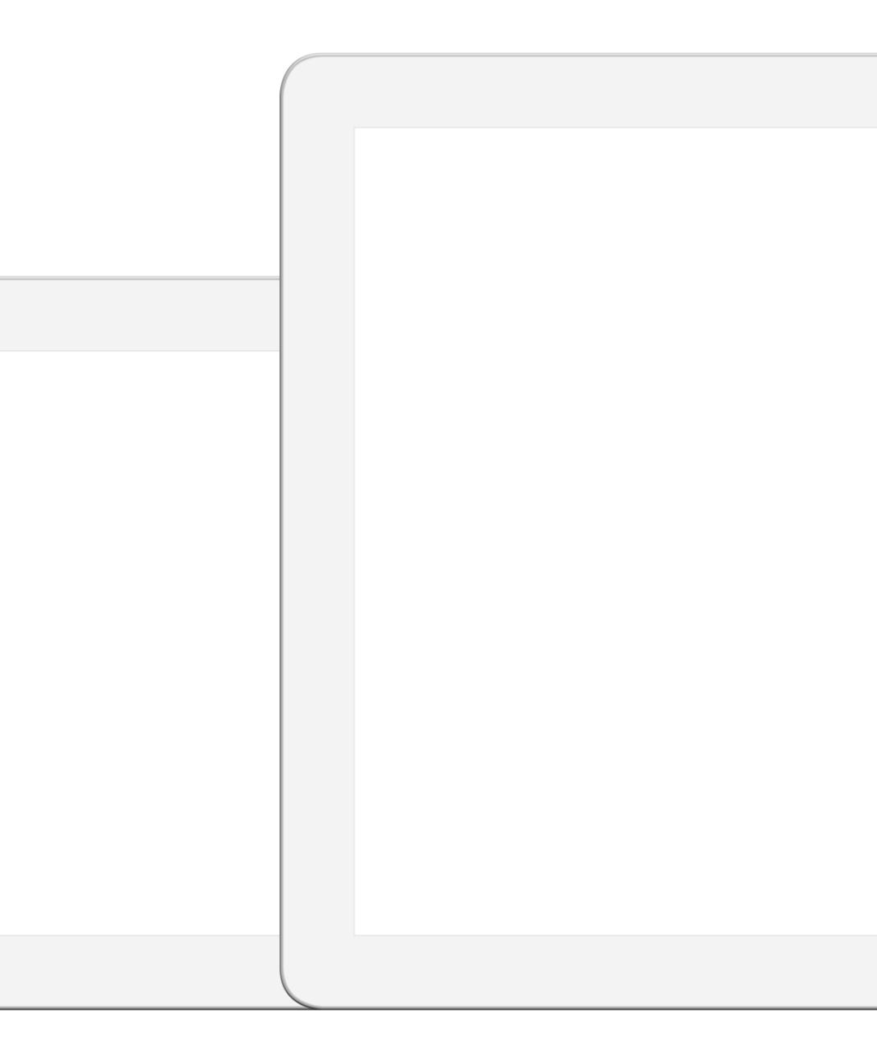
Implementing Responsive Design
Importance of Responsive Design
Responsive design ensures that web applications provide an optimal viewing experience across various devices, enhancing user satisfaction.
Best Practices Overview
Adhering to best practices in responsive design helps maintain website functionality and aesthetics on all screen sizes.
Device Compatibility
Testing for compatibility across devices ensures that all users have a seamless experience, regardless of their device type.
Notes:
Responsive design is crucial for modern web applications. We will cover best practices for ensuring your pages look great on all devices and screen sizes.

Slide 16
Labs and Hands-On Demos
Notes:
Hands-on experience is vital for mastering Power Pages. This section introduces practical labs that will allow you to apply the knowledge gained throughout the presentation.

Slide 17

Lab 1: Creating Your First Power Page
Setting Up Your Page
Begin by setting up your Power Page environment, preparing for customization and content creation.
Customizing Your Layout
Learn how to customize the layout of your Power Page to reflect your desired style and functionality.
Applying Theory to Practice
Put the theoretical knowledge into practice by implementing your design ideas and features on the Power Page.
Notes:
In this lab, you will create your first Power Page from scratch. Follow the guided steps to set up and customize your page, putting theory into practice.

Slide 18
Lab 2: Working with Power Page Entities and Authentication
Understand Power Page Entities
Learn how to integrate different parts of entity list, forms and other components such as site markers, content snippets, web templates and more
Design Custom Pages
Move past OOTB configurations and leverage the full power of the Pages toolkit to build something truly custom with minimal effort
Implement a robust Authentication system
Leverage Azure ADB2C and integrate a custom auth solution for your users.
Notes:
Enhance your web pages by adding custom components. This lab will provide instructions on integrating interactive elements that improve user engagement.

Slide 19

Lab 3: Integrating Data and Interactive Elements
Data Integration Techniques
Understanding data integration is crucial for creating dynamic web applications that utilize various data sources effectively.
Adding Interactive Elements
Incorporating interactive elements enhances user engagement and improves the overall functionality of your Power Pages.
Building Dynamic Applications
This lab guides you in building functional web applications that respond to user input and display data dynamically.
Notes:
Learn how to integrate data sources and add interactive elements to your Power Pages. This lab will help you build functional and dynamic web applications.

Slide 20
Advanced Features and Best Practices
Notes:
Once you've mastered the basics, it's essential to learn about advanced features and best practices to ensure your applications are effective and secure.

Slide 21

Securing and Managing Pages
Importance of Security
Understanding the significance of security in web applications is crucial to protect user data and privacy.
Methods for Securing Pages
We will explore various methods such as encryption, authentication, and secure coding practices to safeguard web pages.
User Access Management
Effective management of user access ensures that only authorized individuals can view or modify sensitive information.
Notes:
Security is paramount when building web applications. We will discuss methods for securing your pages and managing user access effectively.

Slide 22

Optimizing Performance
Importance of Performance Optimization
Optimizing performance is essential for enhancing user satisfaction and retaining visitors on your platform.
Improving Loading Times
Implementing techniques to reduce loading times can significantly improve the user experience and engagement.
Techniques for Optimization
Explore various techniques such as image compression, caching, and minimizing code to enhance performance.
Notes:
Performance optimization is critical for user satisfaction. Learn techniques to improve loading times and overall performance of your Power Pages.

Slide 23

Troubleshooting and Support Resources
Common Troubleshooting Strategies
Even seasoned developers face challenges. Understanding common troubleshooting strategies can help resolve issues effectively.
Support Resources
Access to valuable support resources such as documentation, forums, and community support can assist in problem-solving.
Notes:
Even experienced developers encounter issues. We will cover common troubleshooting strategies and point you to valuable support resources to assist you.

Slide 24
Conclusion
Powerful Tool for Web Development
Microsoft Power Pages provides a robust platform for creating dynamic and interactive web applications tailored to user needs.
Understanding Features
A deep understanding of Power Pages features enables users to maximize the application’s potential in web development.
Best Practices for Success
Applying best practices in web application development ensures effective solutions that align with organizational goals.
Notes:
In conclusion, Microsoft Power Pages is a powerful tool for building dynamic web applications. By understanding its features, mastering its interface, and applying best practices, you can create effective web solutions that meet your organization’s needs.

